Slide 1
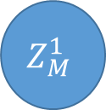
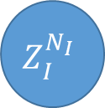
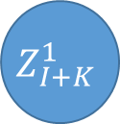


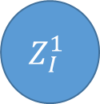
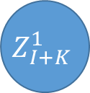

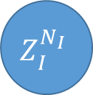
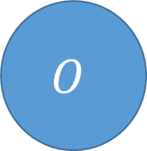
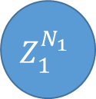


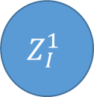

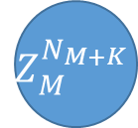
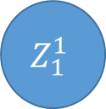
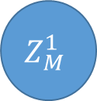
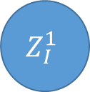
Hidden layers
Intermediate layer
Hidden layers
Input layer
Output
$$Z_{1}^{1}$$
$$Z_{M}^{1}$$
$$Z_{I}^{1}$$
$$Z_{I}^{1}$$
$$Z_{I+K}^{1}$$
$$I$$
$$Z_{1}^{2}$$
$$Z_{M}^{1}$$
$$Z_{I}^{1}$$
$$Z_{I}^{1}$$
$$Z_{I+K}^{1}$$
$$O$$
$$D$$
$$AF$$
$$Z_{1}^{N_{1}}$$
$$Z_{M}^{N_{M}}$$
$$Z_{I}^{N_{I}}$$
$$Z_{I}^{N_{I}}$$
$$Z_{M}^{N_{M+K}}$$

